Slide 1
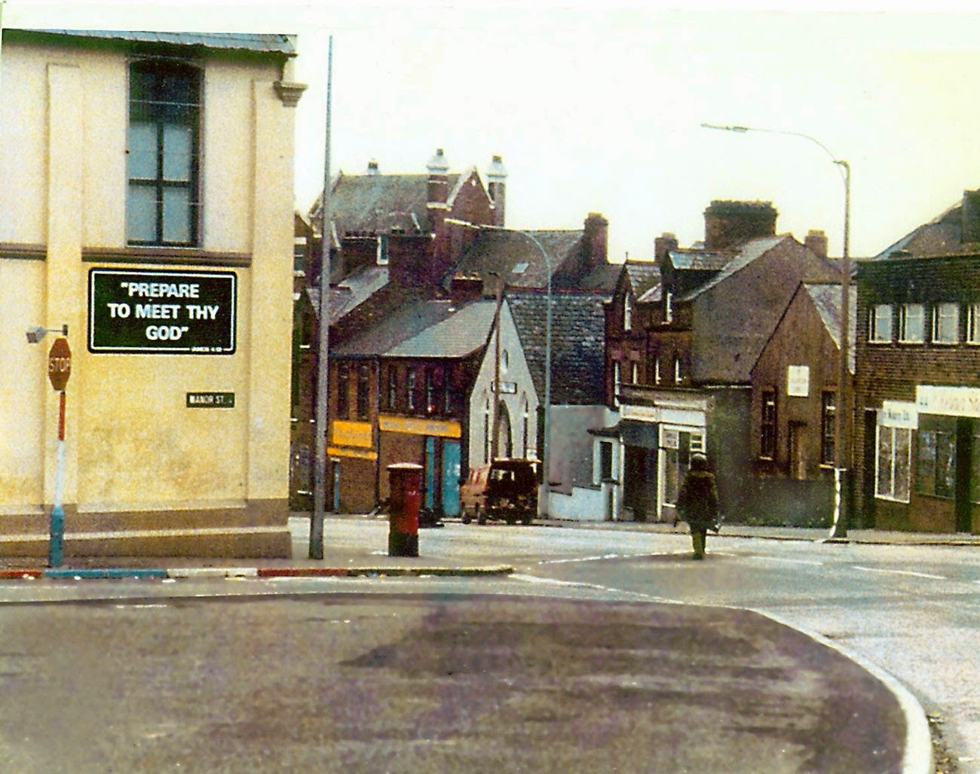
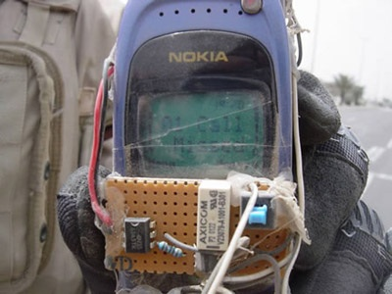
DEADMAN’S ALARM RSP GUI FRAMEWORK
Tre McGowan
01. INTELLIGENT LOGIC
High-contrast arithmetic modules designed for rapid mental awareness under acoustic stressors.
02. REAL-TIME FEEDBACK
Real-time volume-to-time mapping with 0-100% saturation indicators across the hazard duration.
03. FAIL-SAFE DESIGN
Escalating validation protocol ensuring the operative remains conscious to prepare for the 'long walk'.

